Slide 1
AGENTIC DEBUGGING WITH TIME TRAVEL
GREG LAW CEO Undo.io

Slide 2
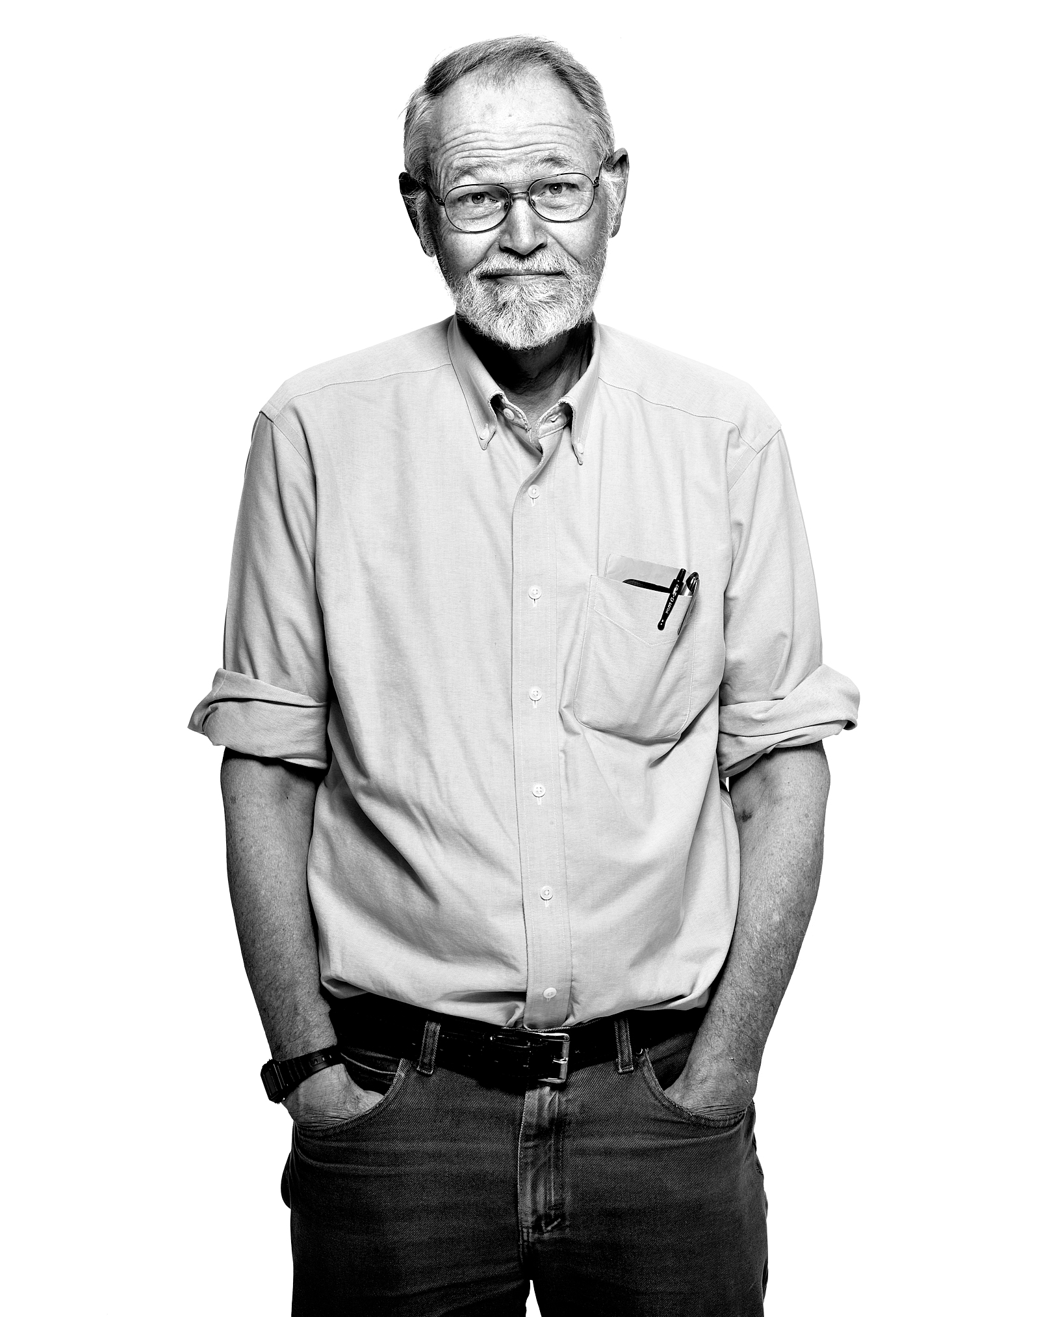
Everyone knows that debugging is twice as hard as writing a program in the first place.
So if you're as clever as you can be when you write it, how will you ever debug it?
Brian Kernighan

Slide 3


Slide 4

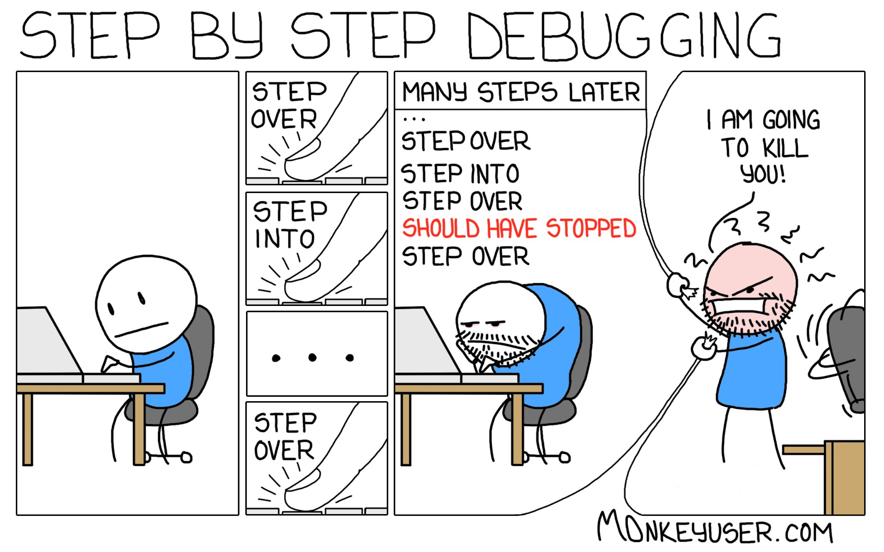
printf’s
vs

Slide 5

Worth $7,900!

Slide 6















EDA & Computational Software
Semi- Conductors & Silicon Design
Financial Services
Data Management
Networking & Security

Slide 7

How did that happen?

Slide 8
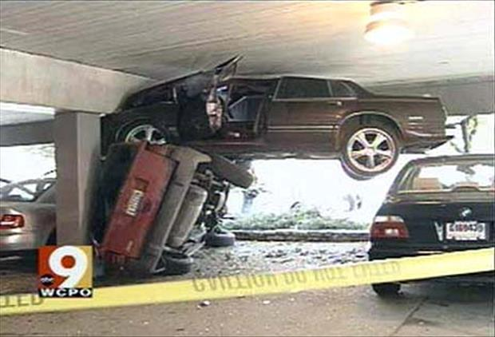

Slide 9
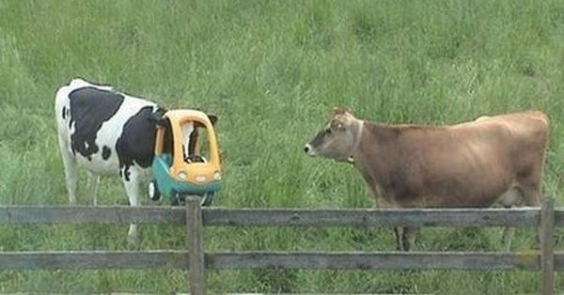

Slide 10
Expectations
Reality

Slide 11



Slide 12
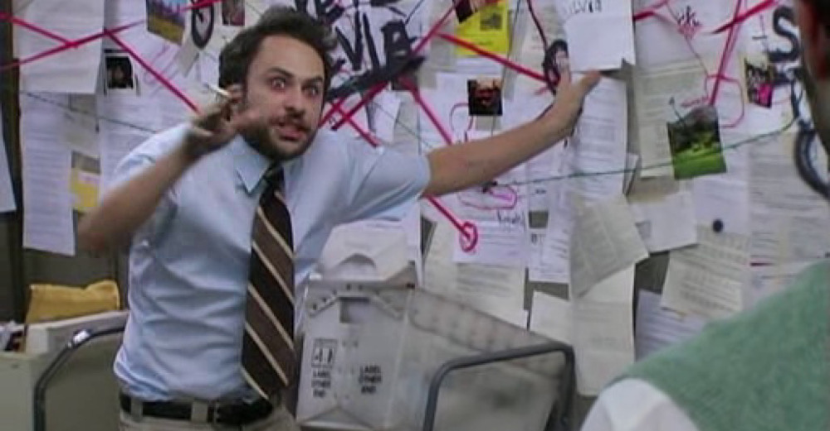

Slide 13

What makes bugs hard to find?
Non-deterministic
‘Heisenbugs’
Time between bug and failure

Slide 14
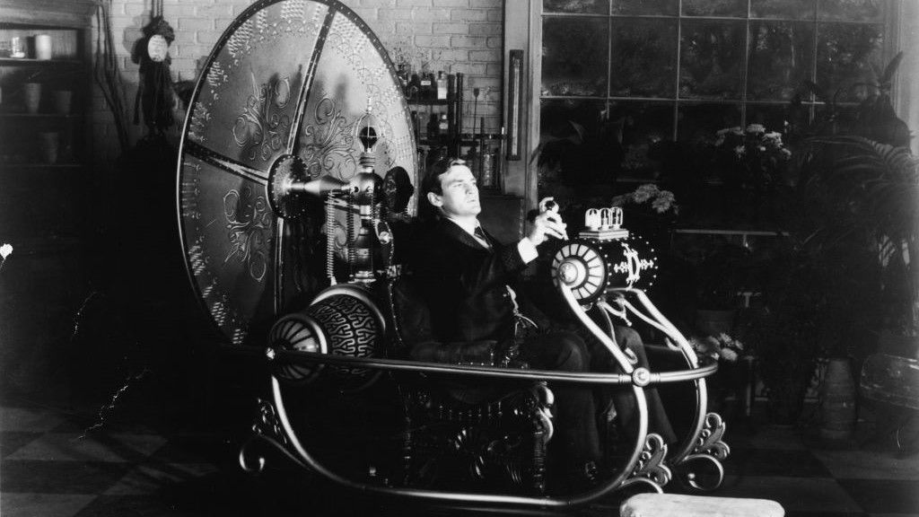

Slide 15
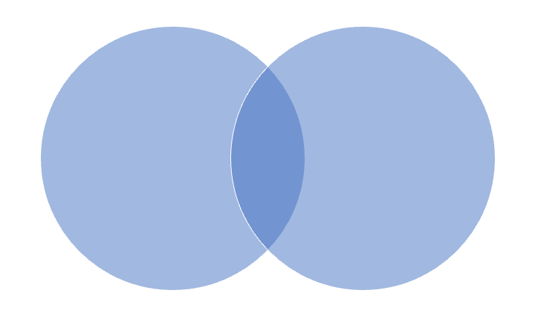
What happened… in detail
Interrogate program without recompiling
See what happened
Time travel
Printf logging
Debuggers
Notes:
Developers can quickly and easily see exactly what the software did and why. There is no more guesswork, no more “it seems that”.
Reproduce the bug every time
Users can easily demonstrate exactly what the issue is to (remote/external) developers (and user error be identified quickly and easily)
Bug reports include more details (root cause)
No need to collect 100s of files to reproduce the env / situation
Fully root cause, not just spot fix
Engineers and Management happy
Release deadlines met
100% of engineer time spent in development and no debugging

Slide 16
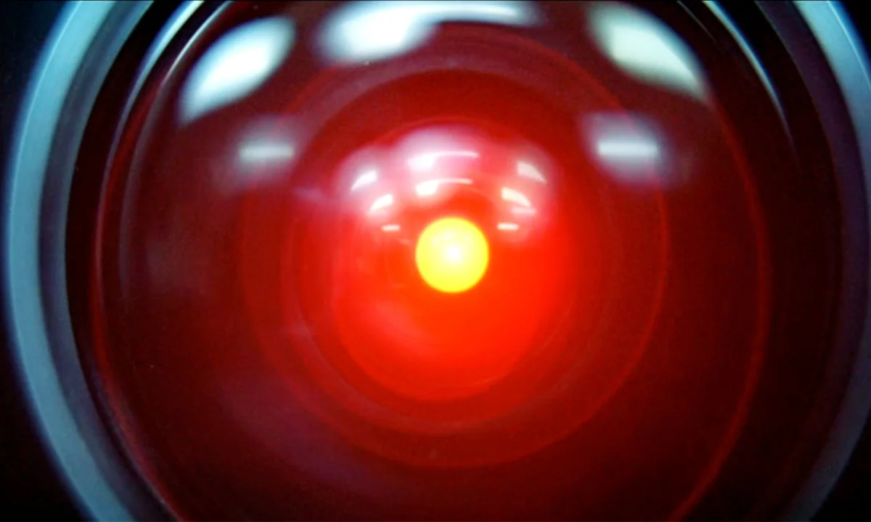
Agentic Debugging

Slide 17
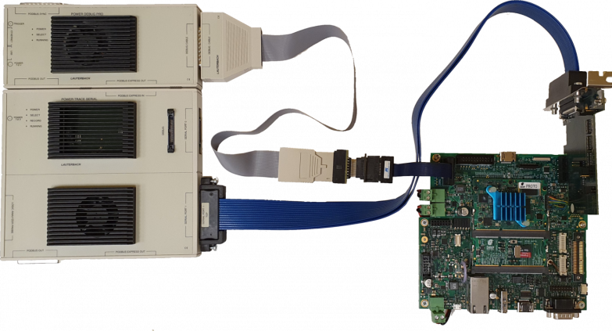
C++ PRODUCTS & PROJECTS
Linux
Undo - UDB & LiveRecorder
rr (rr-project.org)
GDB (ish)
Windows
WinDBG TTD
Embedded
Lauterbach “TRACE32”
Green Hills TimeMachine

Slide 18
OTHER LANGUAGES
JavaScript / React replay.io
.Net RevDebug, Visual Studio
Java Undo
Rust, Go Undo, rr
Python Undo (RSN)

Slide 19
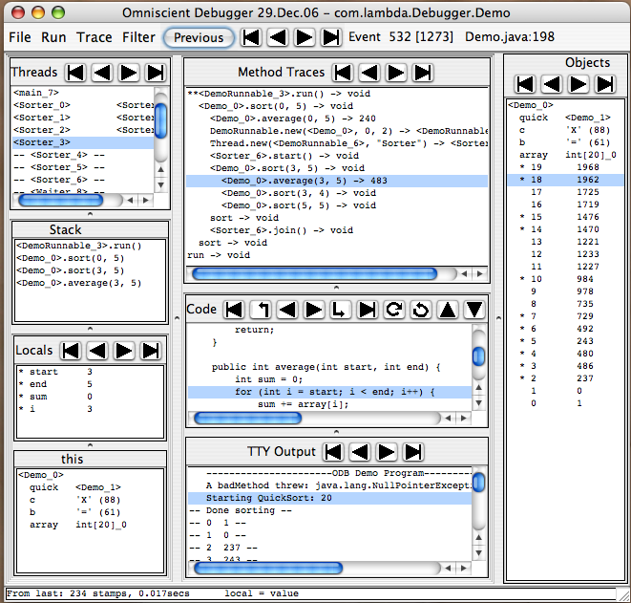

Slide 20
Design Decision 1.
How to remember

Slide 21
What happened?
What was the previous state?
Two options:
Save it.
Recompute it.
a = a + 1 ✓
a = b ✗

Slide 22
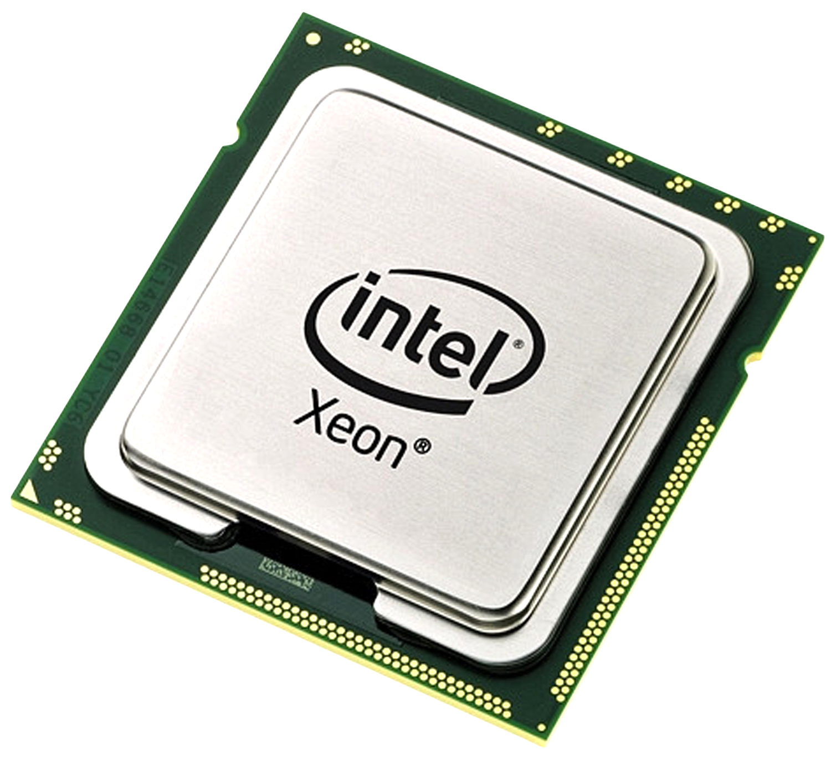
Deterministic re-execution
f(𝒙) →𝒙’

Slide 23
Deterministic re-execution
Snapshots.
Event log.

Slide 24
Non-determinism
What is unpredictable?
System calls.
Thread switches.
Asynchronous events (signals).
Shared memory accesses.
Some machine instructions.

Slide 25
Non-deterministic code
How the technology works
Here’s some machine code in a program that we want to be able to record and replay.
0x000055555555515e mov -0x4(%rbp),%eax
0x0000555555555161 mov %eax,%esi
0x0000555555555163 lea 0xe9a(%rip),%rdi
0x000055555555516a mov $0x0,%eax
0x000055555555516f sub %rdx,%rsp
0x0000555555555171 mov %rcx,%r10
0x0000555555555174 mov $0x11,%eax
0x0000555555555179 syscall
deterministic
nondeterministic
Notes:
The disassembled code on the left is some x86 code. We don’t really mind what it does at this point. It happens to be a basic block.
The effects of most of the instructions here are entirely dependent on the state of the program - the registers and memory. (Assuming there’s no shared memory involved). So if we replay the same instruction with the same state, we’ll always get the same result. They don’t need special handling, in general.
Some instructions - in this case the syscall instruction - are non-deterministic. The results depend on both the state of the program and external factors. In this case we’re doing a read, and that read will end up changing some of the program’s memory. We have to capture the contents of that read, and we do that by running additional code alongside the syscall as part of the translation.
There are a number of sources of non-determinism: system calls, reads from clocks, random number generators, shared memory. (Could ask the audience to suggest some…)

Slide 26
Design Decision 1
Re-execution is the winner

Slide 27
Design decision 2: what exactly to record?
A process?
A thread or function?
A sandbox environment (e.g. JVM or v8?)
Virtual machine?

Slide 28
Recording at process/OS ABI boundary
Process 1
Process 1
Process 2
Process 2
Process 3
libc
libm
Kernel

Slide 29
Design Decision 2 - winner!
Re-execution at the process boundary is the winner

Slide 30
Design Decision 3: How to track time?

Slide 31
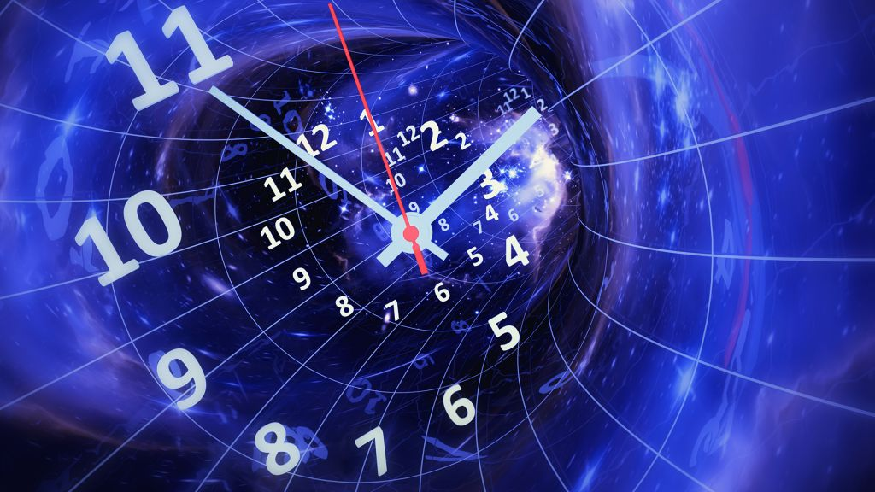
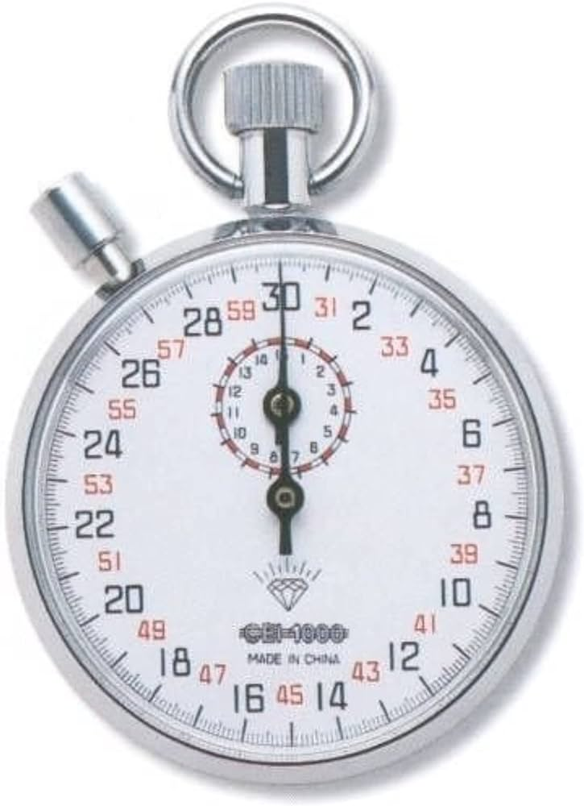

Slide 32
Design Decision 3: How to track time?
To JIT or not to JIT?

Slide 33
Translation and events
How the technology works
Program
Record time
A-code
Undo Instrumentation Engine
Binary Translation
B-code
Instrumentation Cache
Event Log
CPU
Engine Library
System calls
Kernel
Notes:
So, the first secret of Undo is that we only ever go forwards. The second secret is that we never actually run your code. Instead, we translate every instruction your program would have run into a version that lets us capture non-determinism.
We call the original code “A-code” and the translated version “B-code”. That translated code gets cached, because translating it every time would be expensive. That’s the code that actually runs on the CPU.
Occasionally the program does something that needs special handling - for example, it might make a system call in to the kernel, which can have side effects we need to record. Or it might read the CPU timestamp counter, which is another source of non-determinism that we need to record. When this is needed, the B-code calls into what we call the Engine Library here. That code makes the actual system calls (for example) and saves the side effects to what we call the Event Log.

Slide 34
Translation and events
How the technology works
Program
Replay time
A-code
Undo Instrumentation Engine
Binary Translation
B-code
Instrumentation Cache
Event Log
CPU
Engine Library
Notes:
At replay time we do much the same - we translate the program and run those translated instructions on the CPU. In most cases the translations are the same for record and replay.
The difference comes in how we handle non-deterministic instructions - at replay time we read the side effects from the event log and apply them to the program.
Notice that the engine library isn’t actually making system calls during replay. So if your program removed a filesystem during record we won’t do that to the system where you’re replaying.

Slide 35
Perf counters
JIT
Can be very fast.
Simpler (less code).
Works anywhere
With anything*.
Solid

Slide 36
Design Decision 4: Rely on memory determinism?

Slide 37
Memory Determinism
Not
(Much) smaller event logs
Faster single-threaded
Unknown syscalls
Parallel record

Slide 38
Thread serialization
Multithreaded code
write()
read()
Notes:
Threads are serialized
Most bugs can be reproduced
Performance overhead
Parallel system calls
Deterministic replay
—
When the Undo Engine records a program that uses multiple threads it will limit the process to being able to run a single thread at a time. The Engine needs to do this because it needs to capture non-determinstic changes to memory without letting other threads observe the results before we’ve captured it.
Although the threads are run in sequence most race conditions should still be possible to reproduce. Even so, there are a few categories of bugs that will be masked by the recording engine, such as bugs that involve incorrect memory barriers in your code.
The serialisation can also contribute to the performance overhead observed when recording your program, especially for CPU-bound programs. This isn’t as bad as it sounds, though, as multiple threads may be executing system calls at the same time. As illustrated on the right, we can see that one thread may be waiting for a “read” system call to complete while other threads are allowed to run.
When a recording is being replayed, the Undo Engine ensures that threads are replayed in the exact same order as happened at record-time.

Slide 39
Non-determinism
What is unpredictable?
System calls.
Thread switches.
Asynchronous events (signals).
Shared memory accesses.
Some machine instructions.

Slide 40
Design decisions
At what boundary to capture
Binary rewriting instrumentation
All/some/no memory recording
Separate record/replay phases
Parallel thread recording
Undo | rr | WinDbg | replay.io | ODB
proc | proc | proc | proc | JVM
yes | no | yes | no | no
some | none | all* | none | all
yes/no | yes | yes | yes | yes
no | no | yes | no | yes

Slide 41
Debuginfo
(gdb) print foo
<value optimized out>
(gdb)

Slide 42
TIME TRAVEL DEBUGGING
RECORD. REPLAY. RESOLVE.

